Slide 1

Módulo 3
Novidades do asp.net

Slide 2

Módulo 3 - Agenda
Módulo 3 – Novidades do asp.net
One asp.net
Bower, grunt e gulp para front-end
Asp.net dependency injection framework
Tag helpers
View components

Slide 3

Novidades do ASP.NET
Módulo 3 – Aula 1

Slide 4
One ASP.NET
Tudo é asp.net!
Mvc, webpages e webapi
Injeção de dependência nativa
Pipeline novo
Fácil integração do signalr, identity e entity framework
Utilização do owin
Muito, muito, muito, muito mais leve ☺

Slide 5


One ASP.NET
.NETvNext
Openness
Client apps
Web and services
Windows Store, WPF, Windows Forms,
Console apps and related libraries.
ASP.NET vNext: Web Forms, MVC, Web Pages, Web API, SignalR
WCF
Multi-purpose
Device optimized
Native compilation
Small footprint, side-by-side
Cross-device enabled
Cloud optimized
High throughput
Small footprint, side-by-side
Cross-platform enabled
Specialized
Common
Runtime
Compilers
Libraries
Next gen JIT (“RyuJIT”)
SIMD (Data Parallelization)
.NET Compiler Platform (“Roslyn”)
Languages innovation
BCL and PCL
Entity Framework

Slide 6
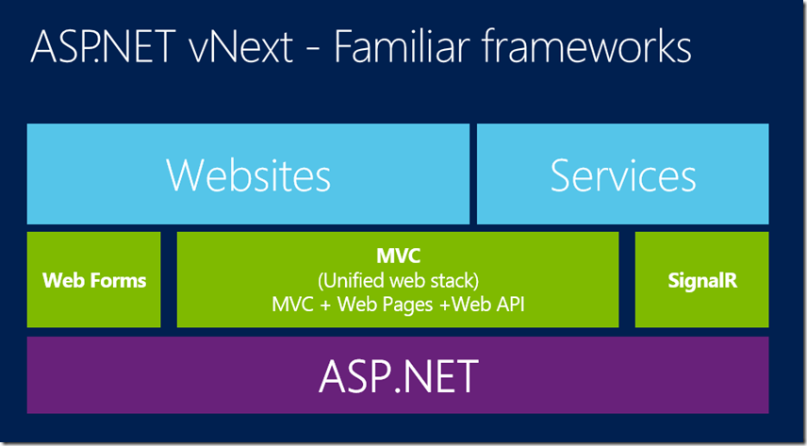
One ASP.NET

